Slide 1
Park Hill Junior School RHSE Parent Information

Slide 2
Home and School Partnership
We aim to inform you of:
The school’s legal obligations on Relationships, Health and Sex Education.
Your rights as a parent/carer.
We wish to consult with you on why, how and what we intend to teach your children in RHSE.

Slide 3
Common Principles
We all want what is best for our children.
We all want to protect our children and keep them safe.
We all want our children to be happy and healthy.
High quality RHSE plays a very important part in this.

Slide 4
Changes to the curriculum
Since Summer 2021 the Department for Education made Relationships and Health Education compulsory in all schools.
-Guidance focuses on healthy relationships and keeping children safe in the modern world.
-It also covers a wide range of topics relating to physical and mental health, well-being, safeguarding and healthy relationships.
-Learning about the emotional, social and physical aspects of growing up will give young people the information, skills and positive values to have safe and fulfilling relationships and will help them take responsibility for their own well-being.

Slide 5
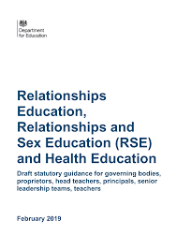
What must we teach in Primary Schools?
Relationships Education is COMPULSORY.
Health Education is COMPULSORY.
Sex Education is at the discretion of the school.

Slide 6
What does the government say is the aim of Relationships Education?
‘Today’s children and young people are growing up in an increasingly complex world and living their lives seamlessly on and offline…children and young people need to know how to be safe and healthy and how to manage their academic, personal and social lives in a positive way.’
DfE guidance on Relationships Education, Sex Education and Health Education 2019

Slide 7
Relationships Education
Relationships Education puts into place the building blocks needed for positive and safe relationships including with family, friends and online.
At Park Hill Junior school your child will be taught; what a relationship is, what family means and who can support them. In an age-appropriate way we will cover how to treat each other with kindness, consideration and respect.
By the end of primary school children would have been taught the following content:
-Families and people who care for me
-Caring Friendships
-Respectful Relationships
-Online Relationships
-Being Safe

Slide 8
What does the government say is the aim of Health Education?
‘The aim of teaching pupils about physical health and mental well-being is to give them the information that they need to make good decisions about their own health and well-being. It should enable them to recognise what is normal and what is an issue within themselves and others and, when issues arise, know how to seek support as early as possible from appropriate sources.’
DfE Primary Health and Mental Well-being 2020

Slide 9
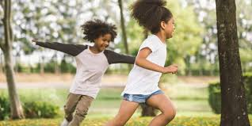
Health Education
Physical and mental well-being are interlinked and it is important that pupils understand that good physical health contributes to good mental well-being and vice versa.
By the end of primary school children would have been taught content on:
-Mental well-being
-Internet safety and harms
-Physical health and fitness
-Healthy eating
-Facts and risks associated with alcohol and tobacco
-Health and prevention
-Basic first aid
-Changing adolescent body.

Slide 10
Delivery of the RHSE Curriculum
We deliver our RHSE curriculum through our Jigsaw PSHE lessons as well as through our Christopher Winter Project scheme of work and Science lessons.
We will be teaching the statutory requirements from the RHSE and science curriculums
We may teach some of the content of the previous year group if there are gaps in learning.

Slide 11
Why is it important to teach RHSE?
RHSE can help prevent prejudice and racism through its emphasis on equality and respect.
It promotes healthy gender relationships and critical thinking skills.
RHSE foregrounds the importance of consent.
70% of young people say they wanted to know more at their first sexual experience, and that they wanted to get this information from school.

Slide 12
What is happening in Croydon and England?
Nearly half of the children in Croydon are overweight or obese
Croydon has a higher rate of teenage pregnancy than other parts of the country.
3,500 London children had to have hospital treatment for tooth decay in 2017-18
Rates of probable mental health disorders have increased in England since 2017. In 2020 one in six children aged 5-16 were identified as having probable mental health disorder (increasing from one in nine in 2017) The increase was evident in both boys and girls.

Slide 13
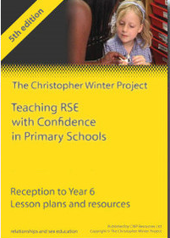
The Christopher Winter Project
The Christopher Winter Project scheme of work provides our children with the knowledge, understanding and skills that enable them to make choices that lead to a healthy lifestyle and develop to their full potential.
Our Relationships and Sex Education programme teaches children about respectful relationships, care and consideration for themselves and others, personal hygiene, parts of the body, puberty, change and reproduction. The programme also aims to equip them with the social skills that enable them to make informed decisions in relation to relationships.

Slide 14
What does a typical lesson look like?
Before teaching any RHSE lesson at Park Hill Junior School teachers will establish these ground rules:
Nobody will be made to talk about anything they don’t want to.
We will use the correct names for parts of our bodies and the things they can do.
If we are worried or scared about anything we can talk to our teacher after the lesson.
Anything we say in this lesson will be kept private, unless we say something that makes our teacher think we need help. If that happens they might have to tell other grown-ups who can keep us safe.
We will be polite and respectful to everyone at all times.
If anyone continues to break our agreement, the consequence will be a lunch time reflection.

Slide 15
What does a typical lesson look like?
All year groups are taught by their class teachers or Senior Leaders.
In Years 3 and 4 all children learn together.
In Years 5 and 6 children are separated into gender groups to learn about specific changes that can occur within their own and others’ bodies as they go through puberty. We find that this helps children feel more confident to ask questions. They also have the opportunity to learn about one another.
Children have the opportunity to write any questions on a piece of paper at the end of the lesson. Teachers then read all questions confidentially and only answer those that are age appropriate. This helps to carefully monitor questions and only share what is appropriate for their cohort.

Slide 16
Parental right to withdraw
The CWP resource forms a spiralling curriculum of Relationships and Sex Education. The Sex Education element of the scheme of work as a whole is in line with the science curriculum. Lessons on puberty form part of the statutory Health Education which means parents do not have the right to withdraw their children from these particular lessons.

Slide 17
What does the government say about Sex Education in Primary Schools?
‘Many primary schools already choose to teach some aspects of sex education and will continue to do so, although it is not a requirement.
It is important that the transition phase before moving to secondary school supports pupils’ ongoing emotional and physical development effectively. The department continues to recommend therefore that all primary schools should have a sex education programme tailored to the age and the physical and emotional maturity of the pupils. It should ensure that both boys and girls are prepared for the changes that adolescence brings and – drawing on knowledge of the human life cycle set out in the national curriculum for science - how a baby is conceived and born.’
DfE Guidance on Relationships Education (Primary) June 2020

Slide 18
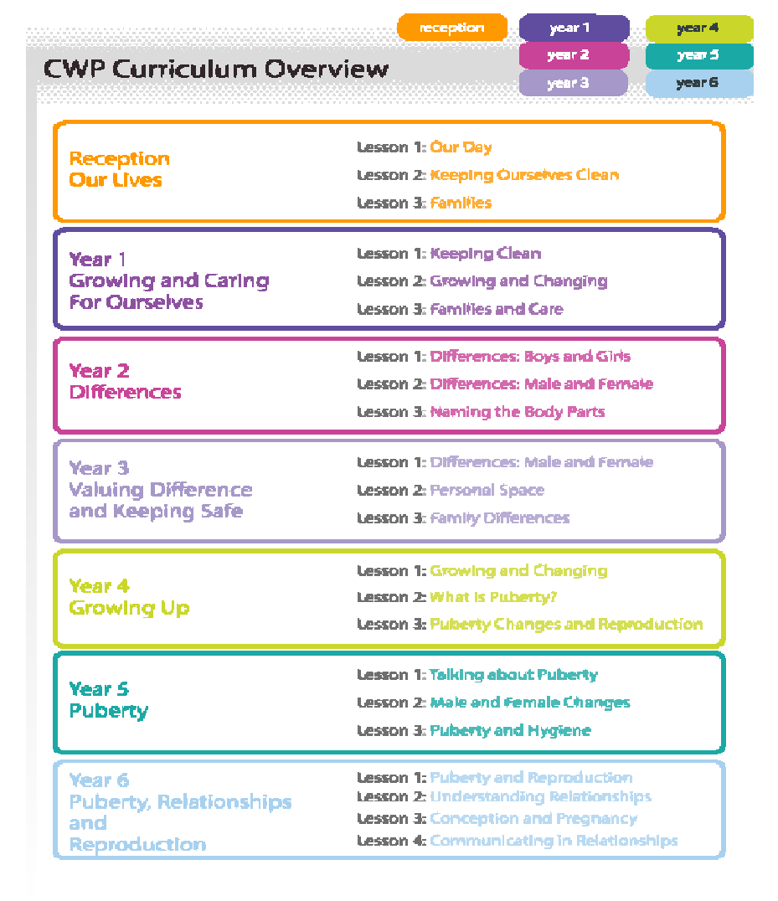
Christopher Winter Project Curriculum overview:
Year Group | Theme | Lessons:
Year 3 | Valuing difference and keeping safe | Lesson 1: Differences in Male and Female Lesson 2: Personal Space Lesson 3: Family Differences
Year 4 | Growing up | Lesson 1: Growing and Changing Lesson 2: What is puberty? Lesson 3: Puberty changes and Reproduction.
Year 5 | Puberty | Lesson 1: Talking about puberty Lesson 2: Male and Female changes Lesson 3: Puberty and Hygiene Lesson 4: Respect and Equality
Year 6 | Puberty, Relationships and Reproduction | Lesson 1: Puberty and Reproduction Lesson 2: Understanding Relationships Lesson 3: Communicating in Relationships
All lessons fall under the statutory guidance for Science and Health curriculums.

Slide 19
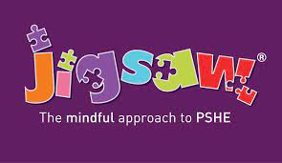
Alongside the Christopher Winter Project which is the scheme of work we use to teach RHSE, Park Hill Junior School is also using the Jigsaw approach to PSHE.
Jigsaw is a teaching and learning program which includes the statutory RHSE and has a strong focus on emotional and mental health and well-being.
Jigsaw believes that this is vital to support children’s development and to underpin their learning capacity and that is the most effective when parents and carers work in partnership with the school. They, like us and parents, want children to be safe, healthy and happy. Jigsaw is respectful of the faiths, beliefs and contexts of our children and their families.

Slide 20

Jigsaw is a comprehensive scheme of work for the whole primary school. The Jigsaw teaching materials integrate; Personal, Social Health Education (PSHE), emotional literacy, social skills, mindfulness and spiritual development in a whole school approach.
The expectations of the DfE Relationships and Health Education guidance are woven throughout Jigsaw. The content is delivered under six headings, each containing six lessons.
The six headings are:
-Being me in My World
-Celebrating Differences
-Dreams and Goals
-Healthy Me
-Changing Me
-Relationships

Slide 21
Statutory Science
In KS2 Science children are required to:
Understand that the life processes common to humans and other animals including nutrition, growth and reproduction.
Learn about the main stages of the human life cycle.
In Years 5 and 6 children will learn to:
Describe the differences in the life cycles of a mammal, an amphibian, an insect and a bird
Describe the life process of reproduction in some plants and animals
Describe the changes as humans develop to old age
Recognise that living things produce offspring of the same kind, but normally offspring vary and are not identical to their parents

Slide 22
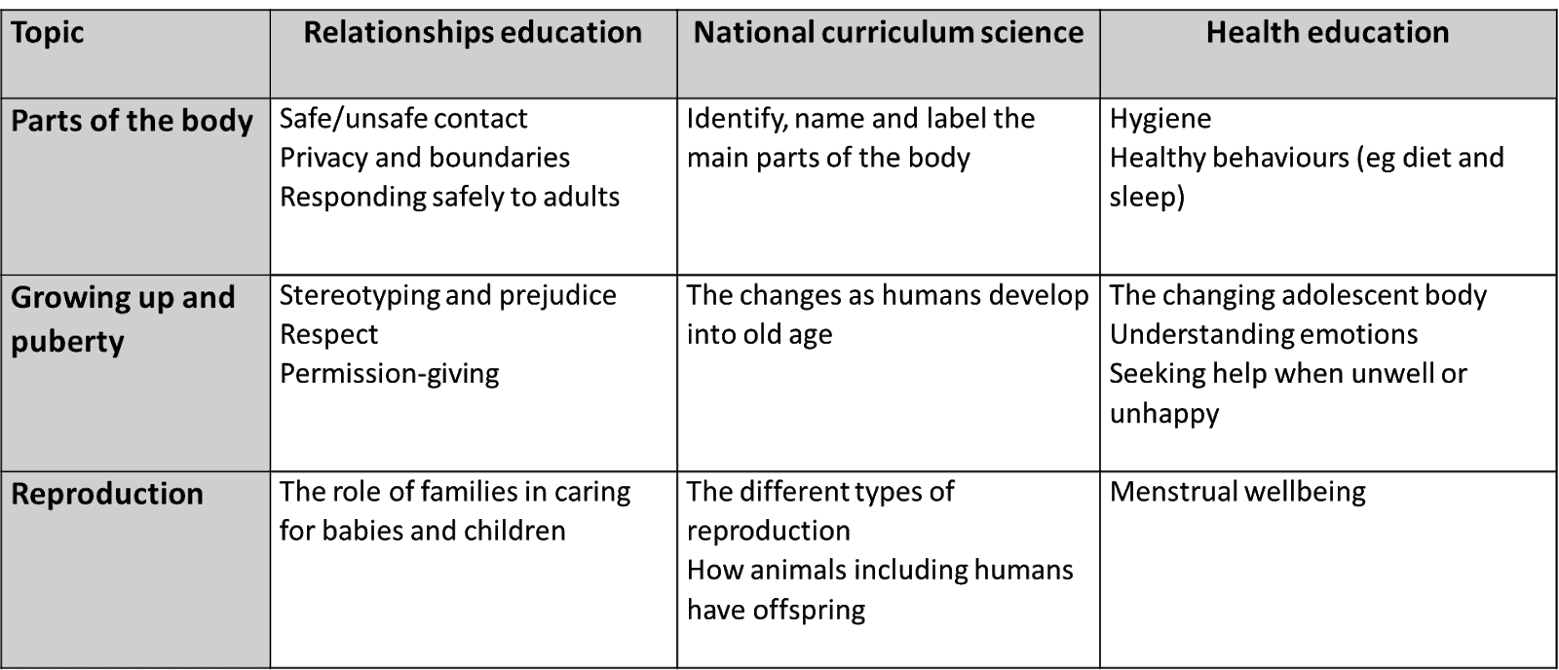
How does the RHSE curriculum fit together?

Slide 23
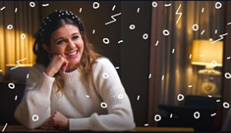
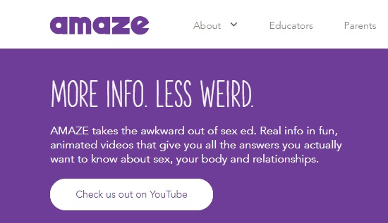
How can you help your child at home?
https://www.bbc.co.uk/newsround/56267456
BBC-Let’s talk about periods
Great for Boys and Girls from year 5.
https://amaze.org/
Resources for:
-Sex Education
-Puberty
-Same sex relationships

Slide 24
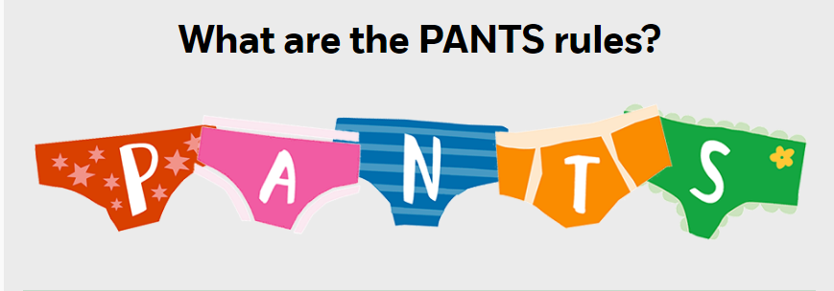
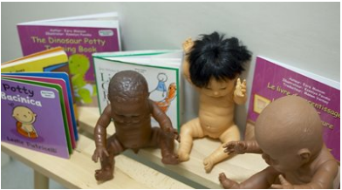
How can you help your child at home?
https://www.nspcc.org.uk/keeping-children-safe/support-for-parents/pants-underwear-rule/
NSPCC-Private body parts
https://www.pacey.org.uk/news-and-views/pacey-blog/october-2019/teaching-children-about-their-private-parts/
Information for parents on how to teach the names of the private body parts and why this is important for a child’s body confidence and self esteem.

Slide 25
If you have further questions
We are very happy to answer any questions you may have. Please see your child’s Class Teacher or Phase Leader after school.
Alternatively you can email the school office with your query, office@phjs.foliotrust.uk marking your email with RHSE so that it can be forwarded to Miss Turner or Ms Dempsey.
We look forward to working with you in parent partnership, remembering:
We all want what is best for our children.
We all want to protect our children and keep them safe.
We all want our children to be happy and healthy.

